Slide 1
Credit Card Fraud Detection using Machine Learning
Surya Devathi
N659A624

Slide 2
Motivation
• Cyber Crimes happening today.
• It happened to me.

Slide 3
Introduction
Unauthorized account activity by someone who the account does not belong to.
Increase in non-cash transaction = More opportunity for credit card fraud.
2009 – Total cost of fraudulent activity in banks the US alone was $86 Billion!
In order for retailers and banks to not lose money, procedures must be put in place to detect fraud prior to it occurring.

Slide 4
Types of Credit Card Frauds
Physically using card to purchase goods.
“Card Not Present”
E-Commerce
Copying of Magnetic Strip
Popular at Gas Stations
Lost or Stolen Card
Applying for new credit cards with an individual’s stolen information

Slide 5
How Fraud is Detected
Companies have a wealth of transactional and historic fraud data.
What variables lead to or predict fraud?
Good News: Fraud tends to occur in patterns
Billons of credit card transactions are made annually…. Companies cannot analyze each one in isolation. Having predictive algorithms in place based on historical data allows company to “flag” possible fraudulent transactions.
This is where “Machine Learning” comes into play!!

Slide 6
Literature Review
A comprehensive survey conducted by Clifton Phua and his associates have revealed that techniques employed in this domain include data mining applications, automated fraud detection, adversarial detection.
A similar research domain was presented by Wen-Fang YU and Na Wang where they used Outlier mining, Outlier detection mining and Distance sum algorithms to accurately predict fraudulent transaction in an emulation experiment of credit card transaction data set of one certain commercial bank.
Artificial Genetic Algorithm, one of the approaches that shed new light in this domain, countered fraud from a different direction. It proved accurate in finding out the fraudulent transactions and minimizing the number of false alerts. Even though, it was accompanied by classification problem with variable misclassification costs.

Slide 7
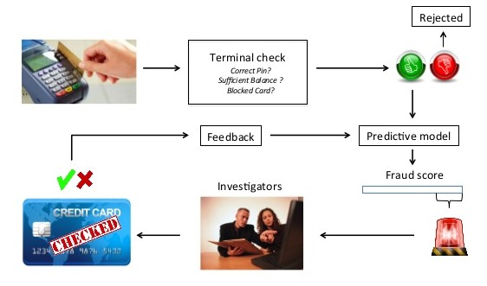
The Fraud Detection Process

Slide 8
Methodology
Explore the dataset
Machine learning approaches for anomaly detection
Local Outlier Factor
Isolation Forest Algorithm
NumPy, SciPy and Matplotlib libraries are used.

Slide 9
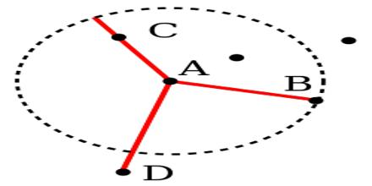
Local Outlier Factor
It is an Unsupervised Outlier Detection algorithm.
'Local Outlier Factor' refers to the anomaly score of each sample. It measures the local deviation of the sample data with respect to its neighbor’s.
More precisely, locality is given by k-nearest neighbor’s, whose distance is used to estimate the local data.

Slide 10
Isolation Forest Algorithm
The Isolation Forest ‘isolates’ observations by arbitrarily selecting a feature and then randomly selecting a split value between the maximum and minimum values of the designated feature.
Recursive partitioning can be represented by a tree, the number of splits required to isolate a sample is equivalent to the path length root node to terminating node. The average of this path length gives a measure of normality and the decision function which we use.
Partitioning them randomly produces shorter paths for anomalies. When a forest of random trees mutually produces shorter path lengths for specific samples, they are extremely likely to be anomalies.

Slide 11
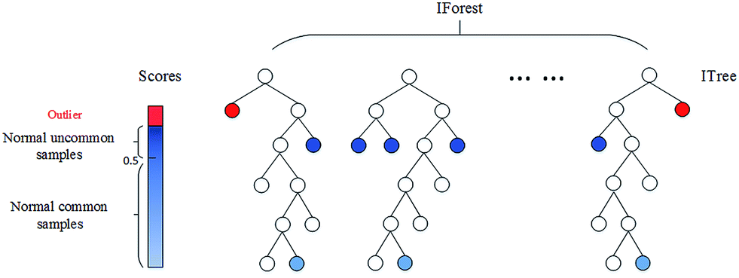
Isolation Forest Algorithm

Slide 12
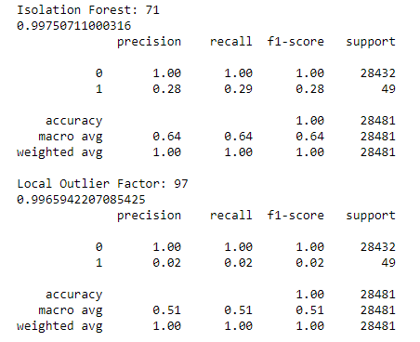
Results
The algorithm does reach over 99.6% accuracy, its precision remains only at 28% when a tenth of the data set is taken into consideration. However, when the entire dataset is fed into the algorithm, the precision rises to 33%.
When 10% of dataset is used :

Slide 13
Conclusion
Since the entire dataset consists of only two days’ transaction records, its only a fraction of data that can be made available if this project were to be used on a commercial scale. Being based on machine learning algorithms, the program will only increase its efficiency over time as more data is put into it.
The nature of this project allows for multiple algorithms to be integrated together as modules and their results can be combined to increase the accuracy of the final result.

Slide 14
References
https://www.kaggle.com/mlg-ulb/creditcardfraud
https://towardsdatascience.com/detecting-credit-card-fraud-using-machine-learning-a3d83423d3b8
Credit Card Fraud Detection Based on Transaction Behaviour -by John Richard D. Kho, Larry A. Vea published by Proc. of the 2017 IEEE Region 10 Conference (TENCON), Malaysia, November 5-8, 2017
Research on Credit Card Fraud Detection Model Based on Distance Sum by Wen-Fang YU and Na Wang published by 2009 International Joint Conference on Artificial Intelligence

Slide 15
Any questions?

Slide 16


Thank you!
16

